Slide 1

SCRAPING PROJECT - ARTSPER x FOUR SEASON
ABELIA PETELLE – JANUARY 2020
Notes:
AFFINE DESIGN : interior architecture, branding and design agency created in 1991 and based in Paris.

Slide 2
CLIENT : Four Seasons Hotels & Resort
CONTEXT : For the oppening of a new hotel in France, Four Seasons Hotels & Resorts wants to create a new concept and to have for each of their rooms a new theme regarding a chosen decade.
CLIENT’S EXPECTATION : To know which artist to look at to fill their rooms with masterpieces that correspond to the chosen decade but also which are still trendy today.

Slide 3
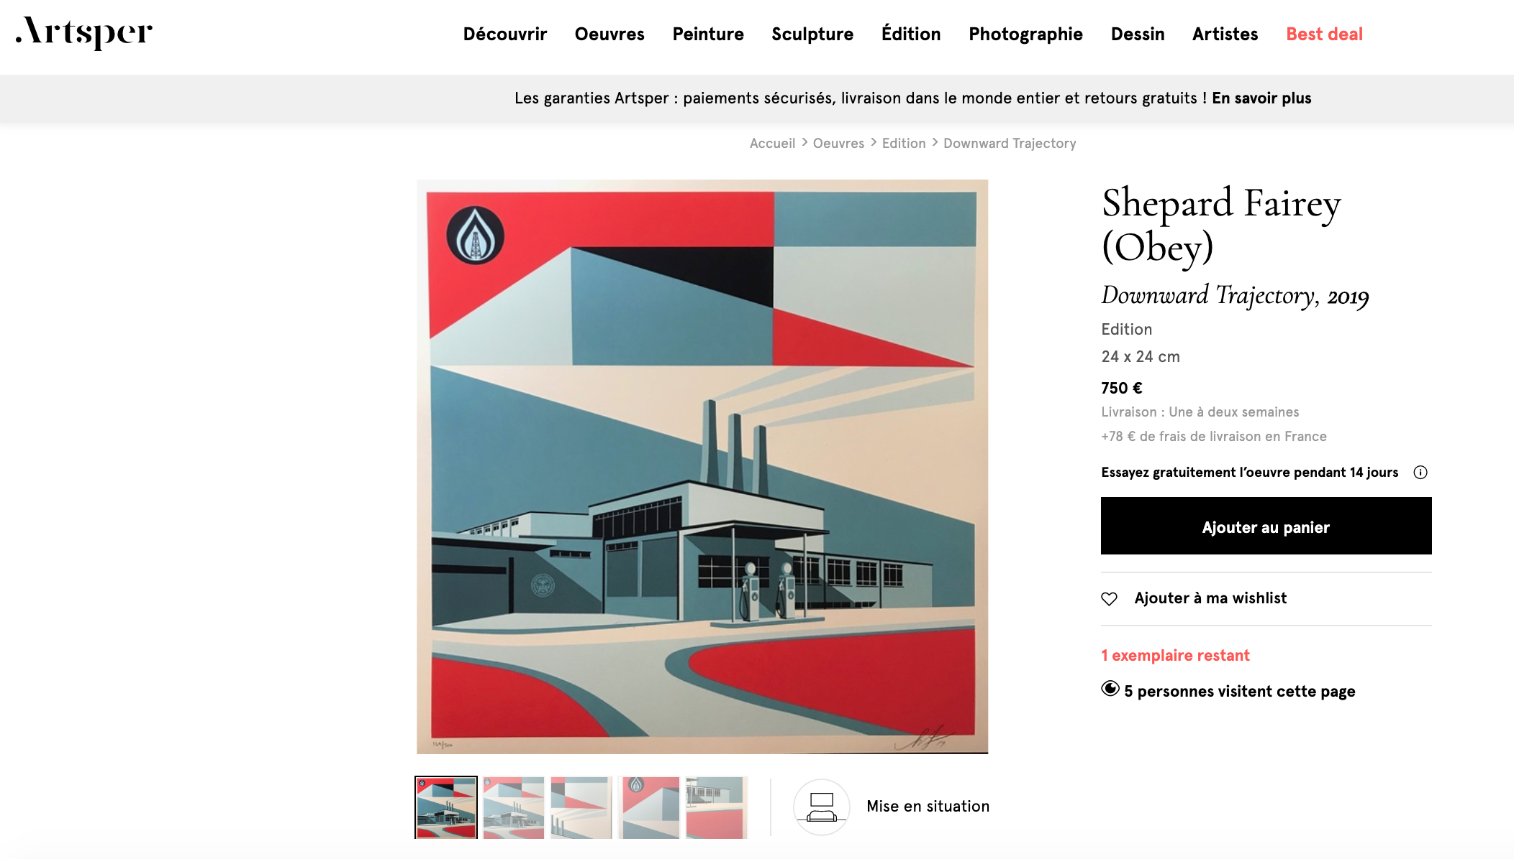
STRATEGY
Collect data from the website Artsper (marketplace who sells masterpieces of art from various wellknown galleries)
in order to see which artists where/are the most present in these galleries.

Slide 4
PROCESS FOLLOWED
Web scraping Artsper.com’s URL & masterpieces pages
Data Frame creation with pandas
Export to a database to stock the data (MySQL)
Standard cleaning process
Strip dates from names
Convert French to English
Create a decade column
Order columns
Analysis
Filter the data regarding the decade & category of art input
Reporting

Slide 5

TOOLS USED
Libraries : requests, BeautifulSoup, pandas, pymysql, create_engine, os, ﻿matplotlib.pyplot, seaborn
Pipelines
Functions : lambda, apply, regex,
List comprehensions
String and interger operations
Error handling

Slide 6
FINAL DATAFRAME
NAME | TYPE | DESCRIPTION
Artist | String | Name of the artist
Name | String | Name of the masterpiece
Date | Integer | Date of the edition of the masterpiece
Decade | Integer | Decade of the masterpiece (1900, 1910 …. 2010)
Category | String | Category of the masterpiece (Edition, Painting, Sculpture, Drawing, Photography)
Theme | Object | Theme of the masterpiece (Street art, Architecture, Paysage urbain, Nus)
Price | Object | Price of the masterpiece
Dimension | Object | Dimension of the masterpiece (HxLxP)
City Galery | Object | City and Country of the Galery
Name & Gallery | Object | Name and Date of the masterpiece
Used for the analysis
4423 rows × 7 columns
Can be used for further analysis

Slide 7
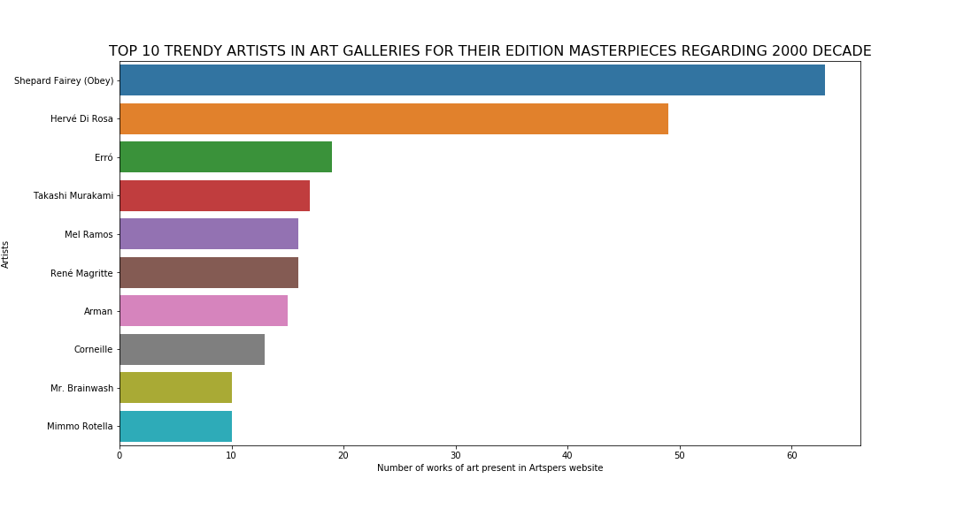
OUTPUT / RESULT
To fill the room « 2000’s » with edition masterpieces, our recommandation is to be interested at the following artists
Notes:
TOP 10 most present artists in arts galleries todays for their ‘ ‘ .lower() work of arts regarding the …. Decade.

Slide 8
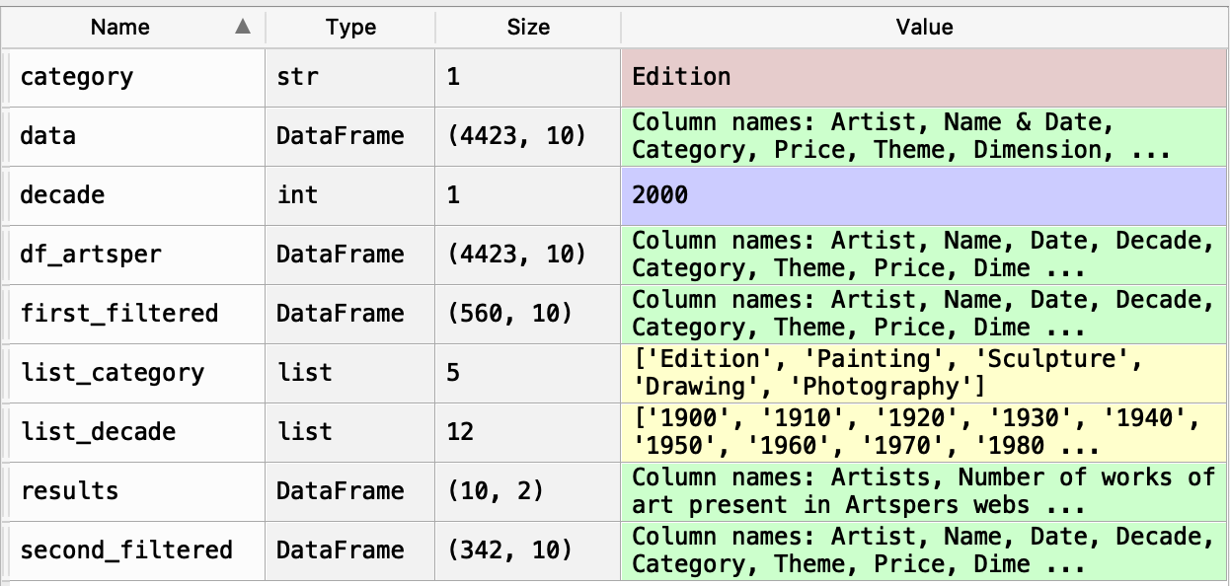

Slide 9
DELIVERABLES
2 Python (.py) code file :
- Artsper scraping pipeline
- Artsper data analysis pipeline
A data folder containing the data set.
An output file containing the histogram analysis (.png) regarding the decenie and category chosen.
A README.md file containing a detailed explanation of the process followed.

Slide 10

ANY QUESTIONS ?

